Slide 1

WELCOME
Mobile And Application Development

Slide 2

ListView
Mobile And Application Development
Practical
Instructor: Muhammad Naeem Khan

Slide 3
What is List?
A list is any information displayed or organized in a logical or linear formation.
It is a view which groups several items and display them in vertical scrollable list.

Slide 4
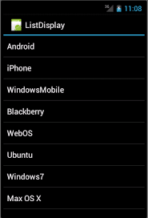
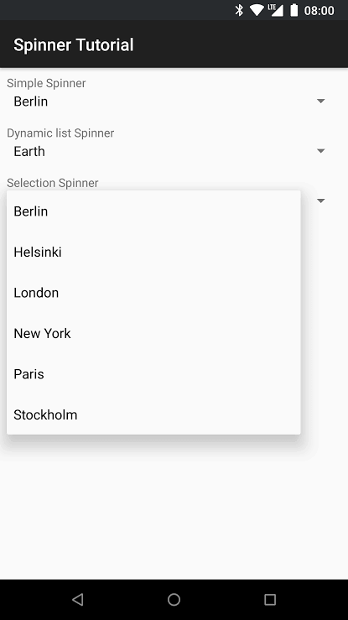
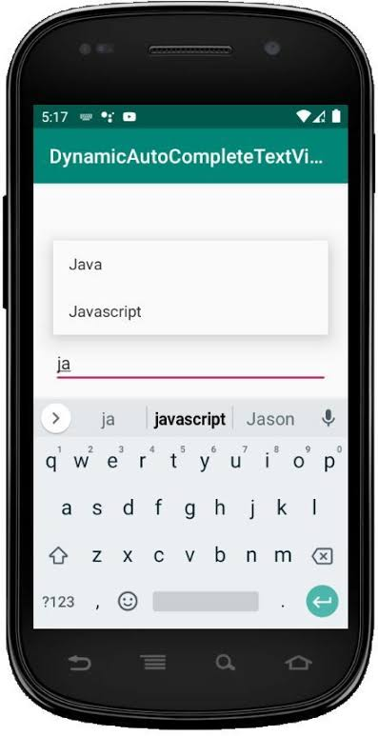
What is List?

Slide 5
How to create ListView?
XML Code | Java Code
<ListView Android:layout_width = “match_parent” Android:layout_width = “wrap_content” Android:id = “@+id/listview”/> | ListView listview; ArrayList<String> arrName = new ArrayList(); int[] arrNo = new int[] {1,2,3,4,5}; listview = findViewById(R.id.listview); arrName.add(“Naeem”); arrName.add(“Khan”); ArrayAdapter<String> adapter = new ArrayAdapter<>(getApplicationContext(),android.R.layout.simple_list_item_1,arrName); listView.setAdapter(adapter); Listview.setOnItemClickListener(new AdapterView. OnItemClickListener(){ if(position = = 0) Toast.makeText(“Clicked First Item”); }

Slide 6
How to create Spinner?
XML Code | Java Code
<ListView Android:layout_width = “match_parent” Android:layout_width = “wrap_content” Android:id = “@+id/listview”/> | Spinner spinner; ArrayList<String> Country = new ArrayList(); listview = findViewById(R.id.spinner); spinner.add(“Naeem”); spinner.add(“Khan”); ArrayAdapter<String> spinnerAdapter = new ArrayAdapter<>(this,android.R.layout.simple_list_item_1,Country); spinner.setAdapter(spinnerAdapter);

Slide 7
How to create AutoComplete
XML Code | Java Code
<AutoCompleteTextView Android:layout_width = “match_parent” Android:layout_width = “wrap_content” Android:id = “@+id/actxtview” Android:hint = “Search here..”/> | AutoCompleteTextView actxtview; ArrayList<String> arrLanguage= new ArrayList(); actxtview= findViewById(R.id. actxtview); arrLanguager.add(“Naeem”); arrLanguage.add(“Khan”); ArrayAdapter<String> actAdapter = new ArrayAdapter<>(this,android.R.layout.simple_list_item_1,arrLanguage); actxtview.setAdapter(actAdapter); Actxtview.setThreshold(1);

Slide 8
What is TableLayout?
Android TableLayout is a ViewGroup subclass that is used to display the child View elements in rows and columns. It will arrange all the children’s elements into rows and columns and does not display any border lines between rows, columns or cells. The working of Android Table Layout is almost similar to an HTML table and it contains as many columns as a row with the most cells. So, in this article, you will learn about Table Layout in Android.

Slide 9
How to declare TableLayout and TableRow?
The TableLayout can be defined using <TableLayout> like below:
<TableLayout xmlns:android="http://schemas.android.com/apk/res/android"
android:layout_width="match_parent"
android:layout_height="match_parent"
android:layout_marginTop="10dp"
android:paddingLeft="5dp"
android:paddingRight="5dp">
// Add Table rows here
</TableLayout>

Slide 10
What is TableLayout?
Row 1
Row 1
Col 1
Row 1
Col 2
Row 1
Col 1
Row 1
Col 2
Row 1
Col 3
Row 1

Slide 11
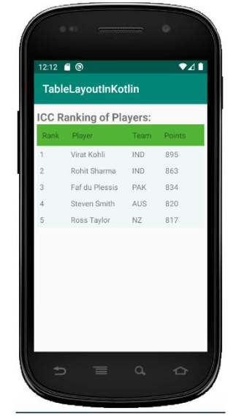
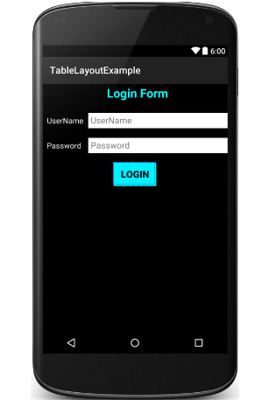
What is TableLayout?

Slide 12
What is FrameLayout?
Android Framelayout is a ViewGroup subclass that is used to specify the position of multiple views placed on top of each other to represent a single view screen. Generally, we can say FrameLayout simply blocks a particular area on the screen to display a single view. Here, all the child views or elements are added in stack format means the most recently added child will be shown on the top of the screen. But, we can add multiple children’s views and control their positions only by using gravity attributes in FrameLayout.

Slide 13
What is FrameLayout?
The FrameLayout can be defined using the code below:
<FrameLayout xmlns:android="http://schemas.android.com/apk/res/android" android:layout_width="match_parent" android:layout_height="match_parent" android:orientation="vertical"> // Add items or widgets here </FrameLayout>

Slide 14
Thank You

